Slide 1
Department of MCA
Slide 1:Title AI-Enhanced Data Visualization for COVID-19 Analysis
Under the Guidance of : Dr.Kalimuthu Sir
By :
Gorantla Naveen
2401600196
Dept. of MCA. KL University.

Slide 2
Problem Statement
During the COVID-19 pandemic, a large amount of data was generated daily across different regions. Most of this data is presented in numerical or tabular formats, which makes it difficult for users to clearly understand the information. Existing systems mainly provide static reports without interactive visual support. Because of this, analyzing trends and identifying patterns becomes challenging for users.
Existing Issues
COVID-19 data is presented mainly in numerical or tabular formats.
Existing systems provide static reports with no interactivity.
Difficult to identify trends and patterns across time and regions.

Slide 3
Scope of the Project
Uses historical COVID-19 data
Focuses on data cleaning and visualization
Provides interactive dashboards for analysis
Supports trend and pattern analysis
Intended for students, researchers, and analysts

Slide 4
Proposed Solution
To overcome the problem, I developed an interactive COVID-19 dashboard using Power BI.
The system converts complex data into simple visual dashboards.
It helps users identify trends and patterns across regions and time.
Basic AI-based trend analysis is used to improve data interpretation.

Slide 5
System Architecture:
The system follows a structured data flow for analysis and visualization.
Components explanation:
• COVID-19 Data Source (CSV/Excel)
• Data Cleaning and Processing
• Power BI Dashboard
• AI Insight Engine
Data flow overview
Data Flow: Data Collection → Processing → Visualization → AI Patterns → User

Slide 6
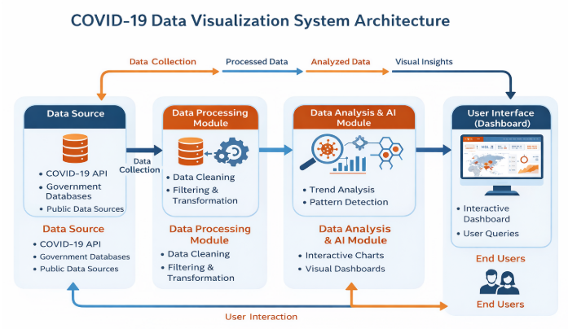

Slide 7
Technologies Used
Frontend: Power BI Dashboard,Python
Backend: Power BI Data Processing Engine
Database:CSV / Excel files
Tools & Libraries:
Pandas
Numpy
Matplotlib.pyplot

Slide 8
Module Description
Module 1 – Data Collection:
Collecting COVID-19 data from reliable public sources such as government websites.
Module 2 – Data Processing:
This module focuses on cleaning, filtering, and organizing the collected COVID-19 data.
Module 3 – Visualization & AI Insights:
This module focuses on creating interactive dashboards and visualizations using Power BI
Users
* Primary Users
* Secondary Users

Slide 9
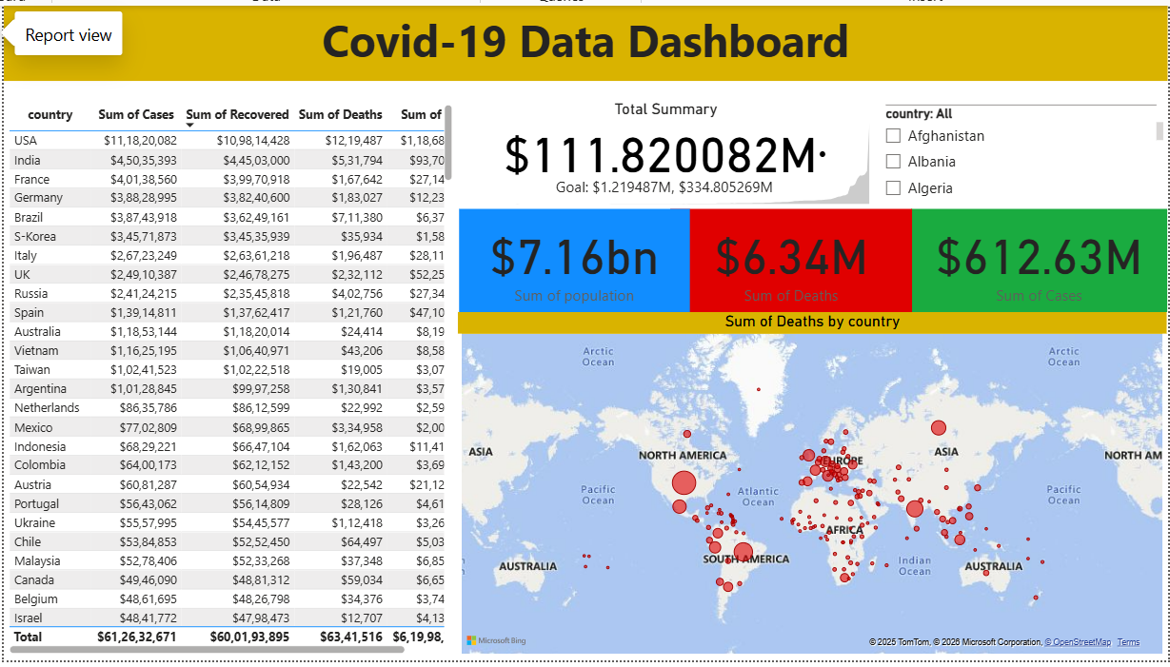
Implementation Status
Completed modules
Data collection
• Data preprocessing
• Dashboard creation (60%-70%)

Slide 10
Conclusion
SUMMARY:
The project successfully converts complex COVID-19 data into meaningful and easy-to-understand visual insights. By using AI-enhanced visualization techniques, the system improves data analysis and helps users identify trends and patterns more effectively.

Slide 11
THANK YOU

